Slide 1

HR ANALYTICS
EMPLOYEE ATTRITION/ RETENTION
Team 3
Shubham Shinde
Aniket Khartad

Slide 2
Project Name: Employee Retention
Project Mentor: Dipti Sinha , Pushparaj Rathore
Domain: HR Analytics
Dataset Name: HR_1 & HR_2
Objective/ Challenge: Reducing the Very high Attrition of Organization
Dataset Type: Excel Data
Dataset Size: 50k records each
Dashboard Visualisation is done through – MS-Excel, Tableau, MYSQL, PowerBI
PROJECT OVERVIEW

Slide 3





AGENDA
Introduction & Problem Statement
Business Objective
KPIS
Dashboard
Conclusion

Slide 4

HR analytics involves the collection and analysis of HR-related data, including employee data, performance metrics, and other relevant data points.
By using advanced analytical tools and techniques, HR analytics provides valuable insights into HR processes and trends, enabling organizations to make more informed decisions about their employees and improve overall performance.
INTRODUCTION

Slide 5
Average attrition rate for all Departments
Average hourly rate of All Job Roles
Attrition rate Vs Monthly Income stats
Average working years for each Department
Job role Vs Work life balance
Attrition rate Vs Years Since last promotion
PROBLEM STATEMENT

Slide 6
The aim of this project is to analyze employee retention and attrition rates with the organization and provide insights to the HR team for developing effective retention strategies. Through data analysis and visualizations, we will identify factors that contribute to :
Employee turnover and attrition.
Evaluate the effectiveness of existing retention strategies.
To verify the satisfaction level of employee in the organization.
Provide recommendations to improve employee retention.
BUSINESS OBJECTIVES

Slide 7
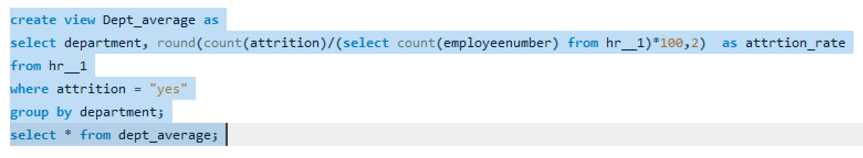
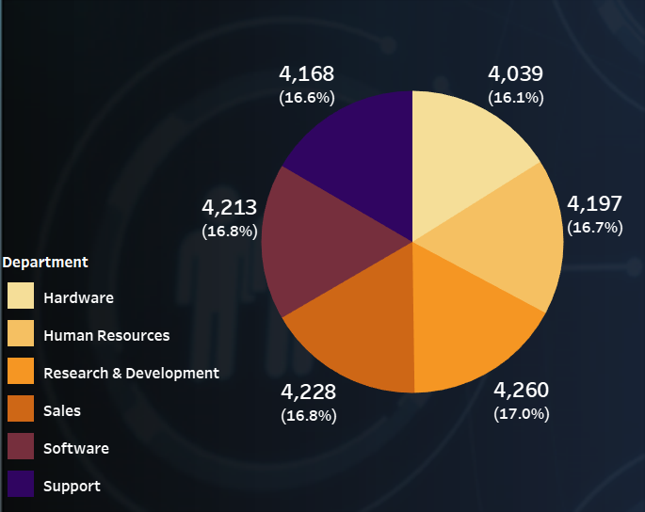
SQL query for the following KPI
KPI – 1
AVERAGE ATTRITION % FOR ALL DEPARTMENTS
OBSERVATION
We can clearly say that attrition rate of employees for every department is almost similar.
This indicates that attrition rate of employees does not depends on department.
Irrespective of the department the general attrition rate is 50% of employees are leaving the company
SUGGESTIONS
This calculation and visualization indicates that we must make strong strategies to minimize attrition rate.
Improve our company’s Employee retention so that we can balance the company’s growth and right talent.

Slide 8
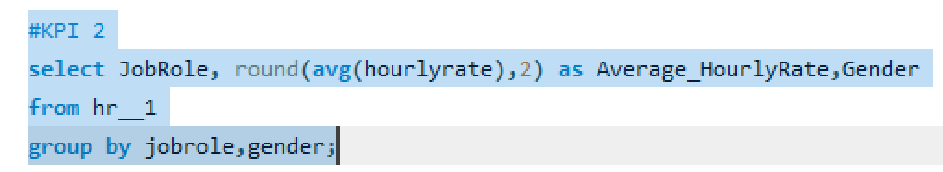
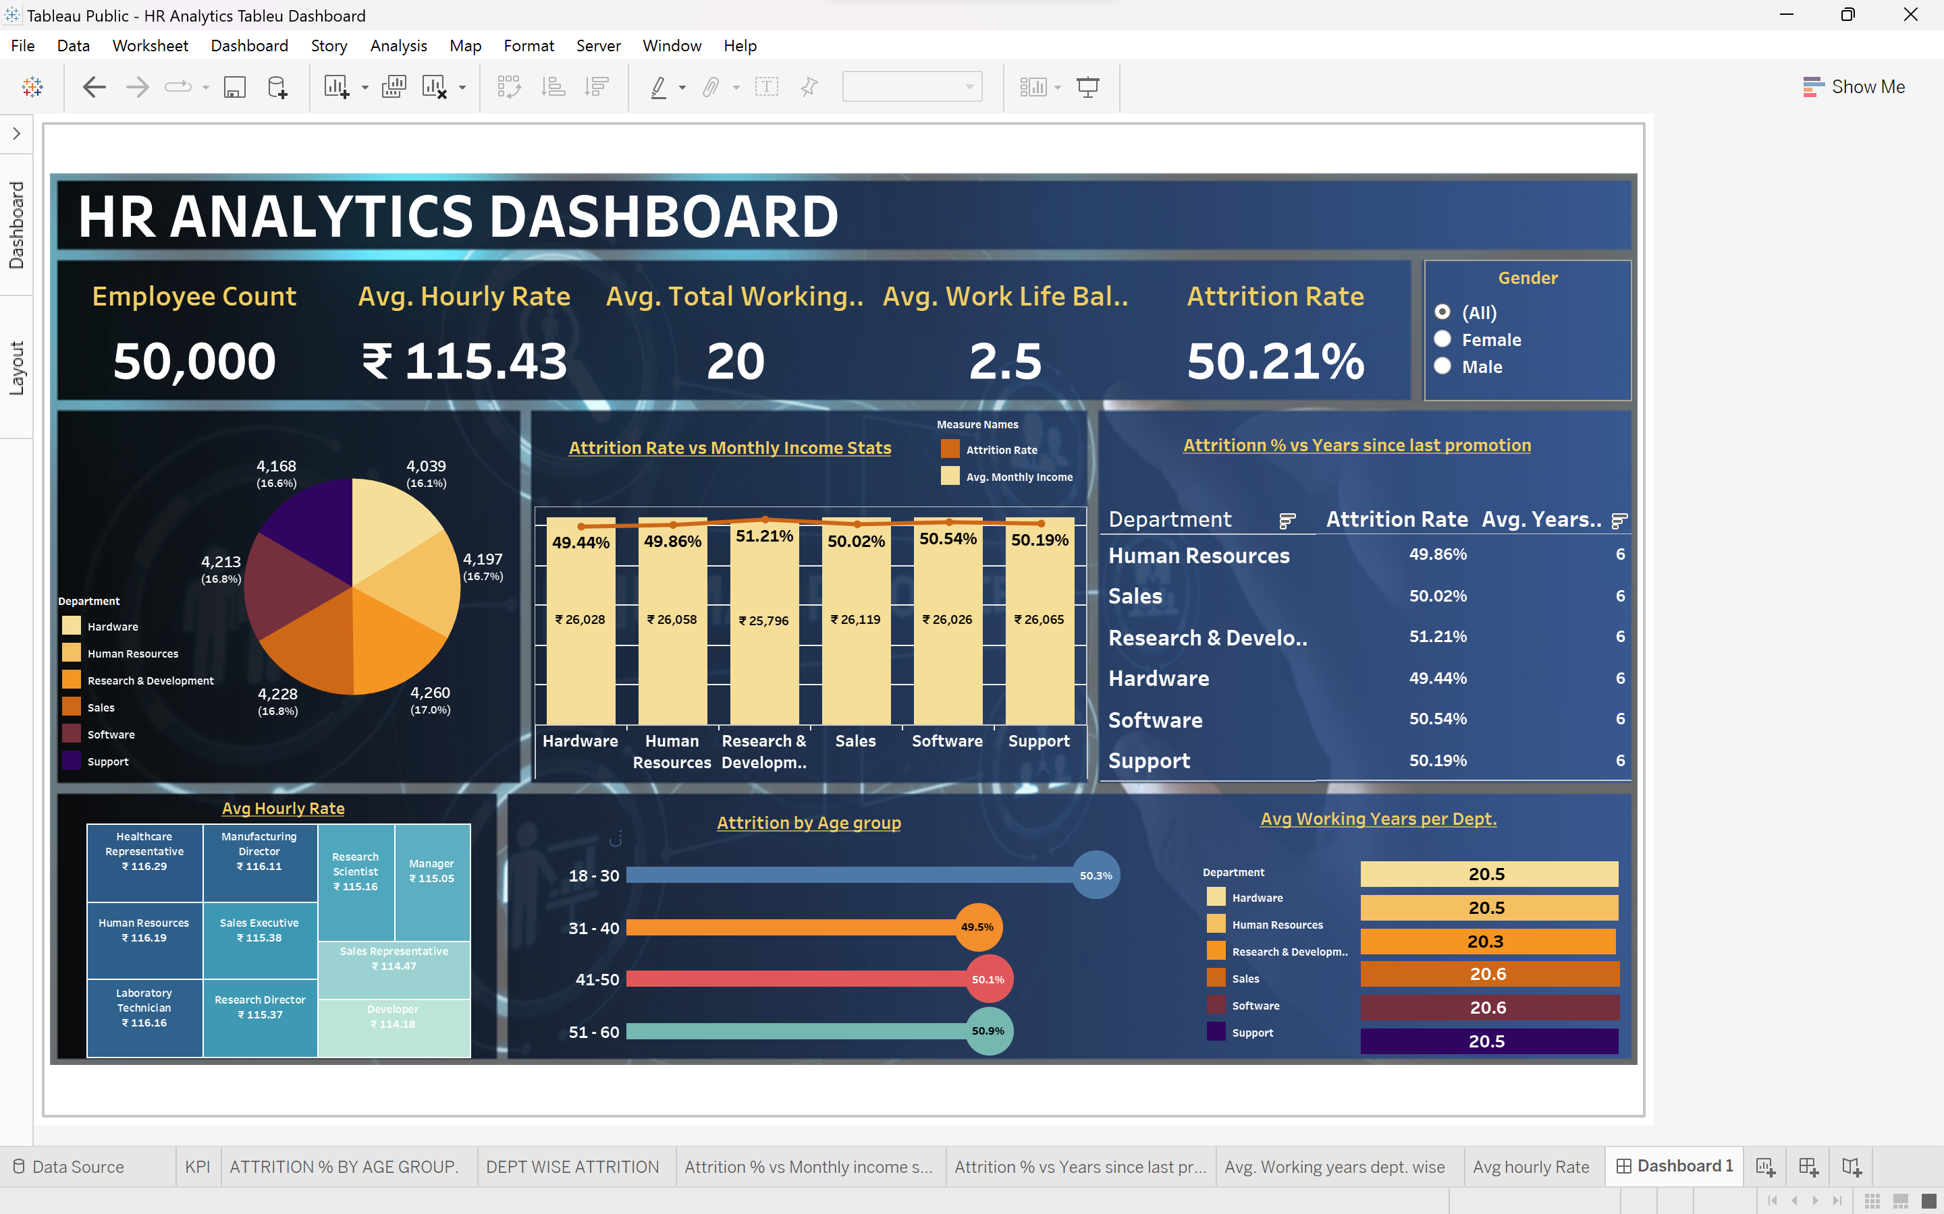
SQL query for the following KPI
KPI – 2
AVERAGE HOURLY RATE OF all Job Roles
OBSERVATION
Average hourly rate means the rate used in calculating premium pay. This rate is determined by taking the average of earnings including wage rate, and shift premium for all hours worked in the payroll week.
Among 50,000 number of employees 25059 are males and 24941 are females.
Healthcare Representative has the highest avg. hourly rate of all Job Roles.
Developer has the Lowest avg. hourly rate of all Job Roles.
SUGGESTION
On considering new skills or certifications relevant to the field, gaining more experience and targeting higher-paying clients or projects and by improving efficiency and productivity can contribute to higher earnings and can increase average hourly rate.
By increasing average income, focusing on career development with regular Performance appraisals and assured raise, continuous upskilling by regular training and development programs- which enhances the motivation and increases the hygiene factors of the organization . Overall , it will improves the average rate automatically.

Slide 9
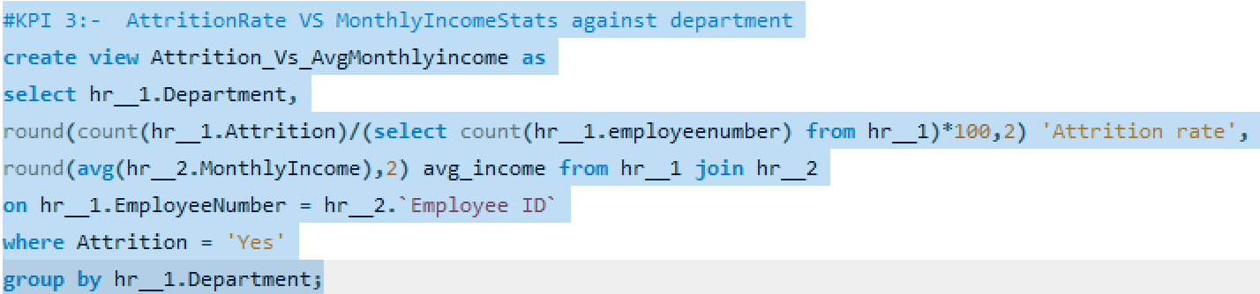
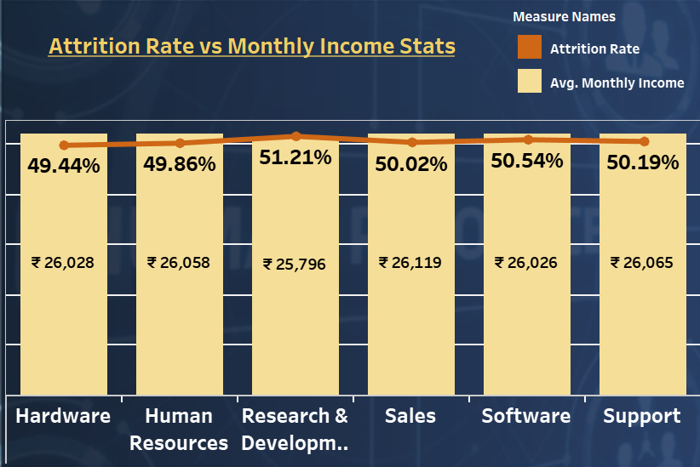
SQL query for the following KPI
KPI – 3
Attrition % vs Monthly Income stats
OBSERVATION
The attrition rates across departments seem relatively close, hovering around 50%. The highest attrition rate belongs to the Research & Development department at 51.21%, while Hardware stands with the lowest at 49.44%
There's minimal disparity in attrition rates among these departments.
The average monthly income varies slightly across departments, with values ranging from 25000 to 26000.
SUGGESTION
Explore non-income-related factors impacting attrition, such as job satisfaction or growth opportunities.
Investigate the reasons behind slight disparity in avg monthly incomes among department , assessing whether if affects job satisfaction and employee retention.
Collect feedback through exit interviews or surveys to comprehend the reasons behind employees leaving.
Provide opportunity for career growth and development to motivate employees to stay.

Slide 10
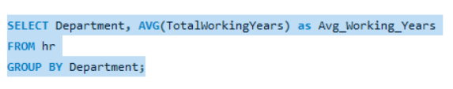
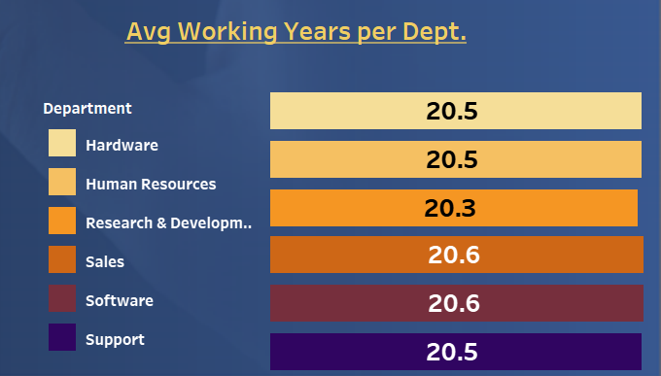
SQL query for the following KPI
KPI – 4
Average Working Years for each Department
OBSERVATION
The Avg Working Years for each Department wise Ranges from 20.30 to 20.65.
The Software is the Department with highest Avg Working Years at 20.65 where as Research and Development is the Department with lowest Avg Working Years at 20.30.
SUGGESTION
Conducting Exit Interviews, Focus more on Research and Development Department as they have lowest Avg Working Years.
Improving Employee Engagement activities in the Company.
Figure out the other factors which are leading more Attrition rate and take necessary actions to over come from it.

Slide 11
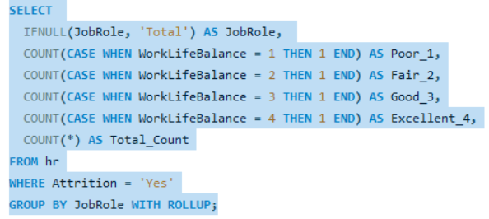
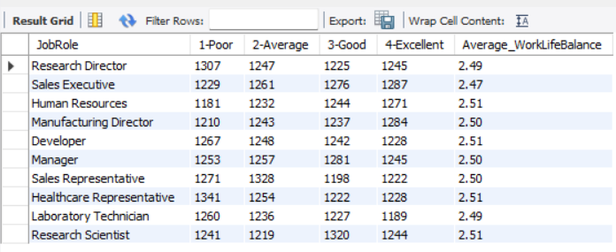
SQL query for the following KPI
KPI – 5
Job Role vs Work-Life Balance
OBSERVATION
The average Work-Life Balance ratings range from 2.47 to 2.51, with most job roles clustered around 2.50.
For Research directors the work life balance is poor.
For the Sales representatives , Manufacturing Directors , managers and Sales executives the work life balance is fair.
For Research Scientists , Healthcare representatives und Developers the work life balance is good.
For Human resources , laboratory technicians the work life balance is excellent.
SUGGESTION
To present the average Work-Life Balance ratings for each job role and discuss the significance of work-life balance for employee well-being and organizational success
Collect employee feedback to understand their work-life balance with respect to job.
Provide career growth, medication, events to motivate employees.

Slide 12
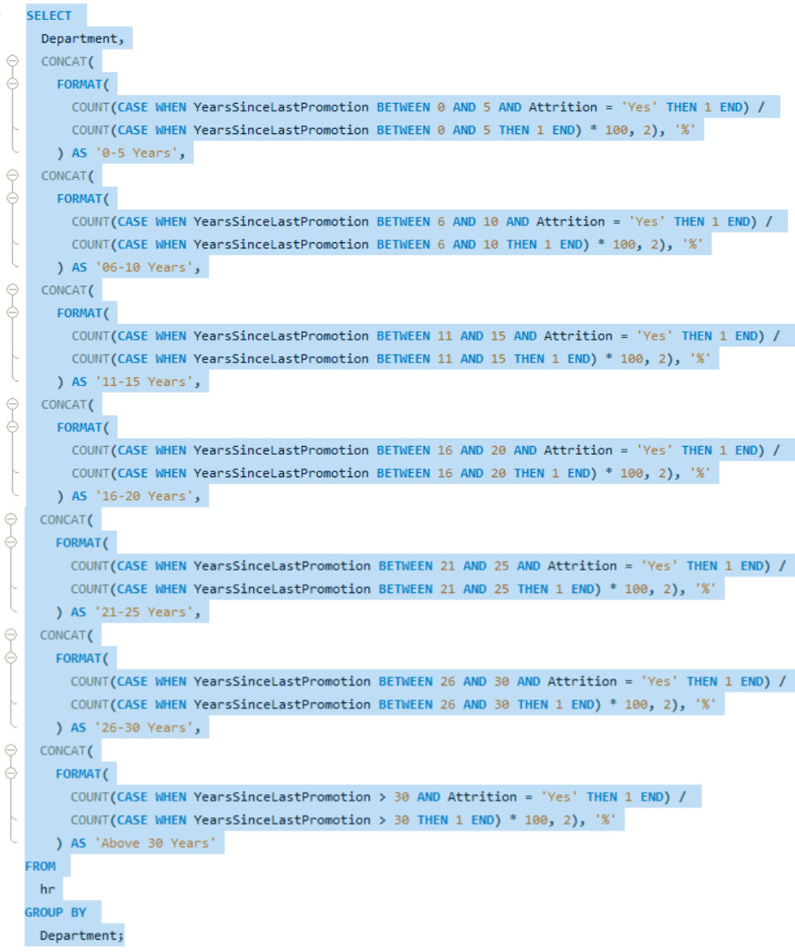
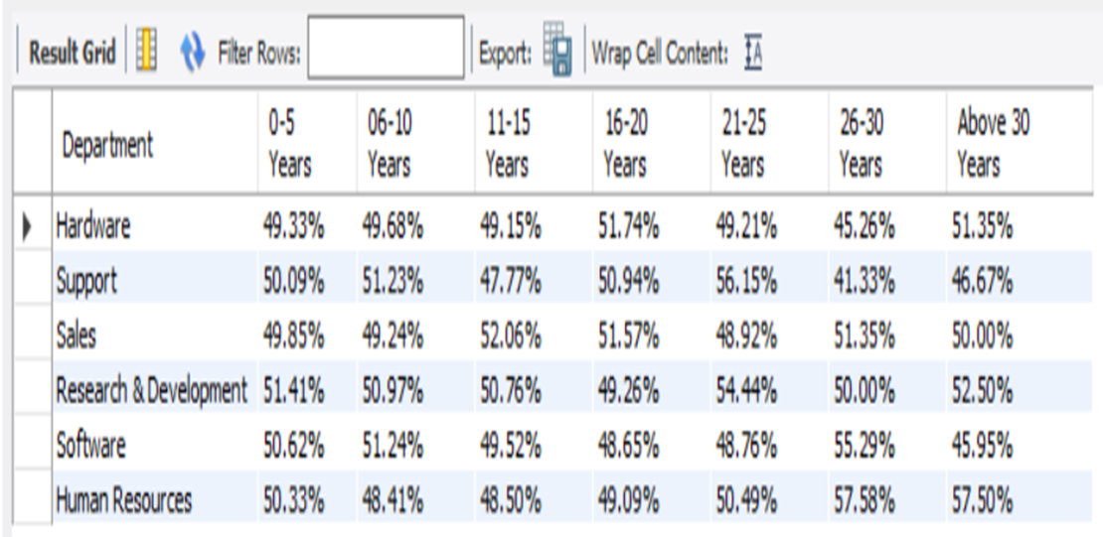
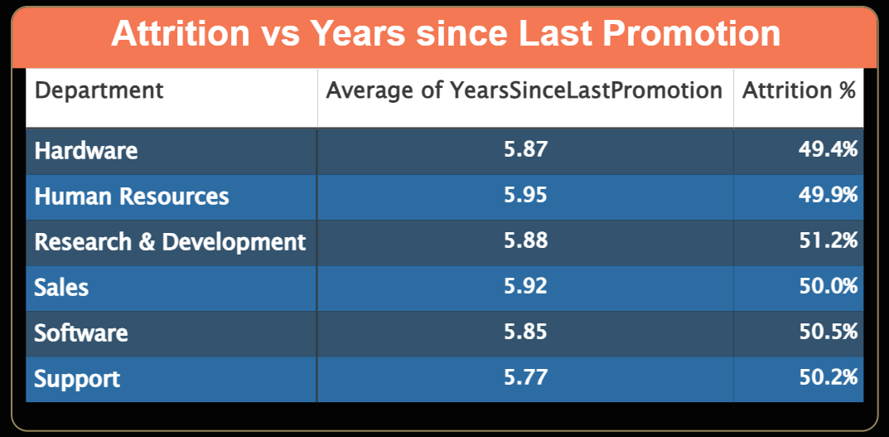
SQL query for the following KPI
KPI – 6
Attrition % vs Years Since Last Promotion
OBSERVATION
For 0-5 years since Last year Promotion interval Research & Development and Hardware departments has highest and lowest attrition rate respectively.
For 6-10 years since last year promotion interval Human resources and software departments has highest and lowest attrition rate respectively.
For 11-15 years since last promotion interval support and sales departments has highest and lowest attrition rate respectively.
For 16-20 years since last promotion interval software & hardware departments has highest and lowest attrition respectively.
For 21-25 years since last promotion interval software and support departments has highest and lowest attrition respectively.
For 26-30 years since last promotion interval support and Human resources departments has highest and lowest attrition respectively.
For above 30 years since last promotion interval software and Human resources departments has highest and lowest attrition respectively.

Slide 13





Conduct stay interviews: Instead of exit interviews, conduct stay interviews with employees to gather feedback about the job.
Improve employee engagement: Implement initiatives to improve employee engagement, such as regular feedback, recognition and rewards programs, and opportunities for career growth.
Address workload issues: Ensure employees have manageable workloads by regularly monitoring and adjusting workloads to prevent burnout and overwhelm.
CONCLUSION
Create a positive work environment: Foster a positive work environment by promoting a culture of respect, inclusivity, and teamwork. Encourage open communication and collaboration among employees.
Address pay and compensation issues: Ensure that employees receive fair pay and compensation for their work and to find out what motivates an employee to continue to work in an organization.

Slide 14
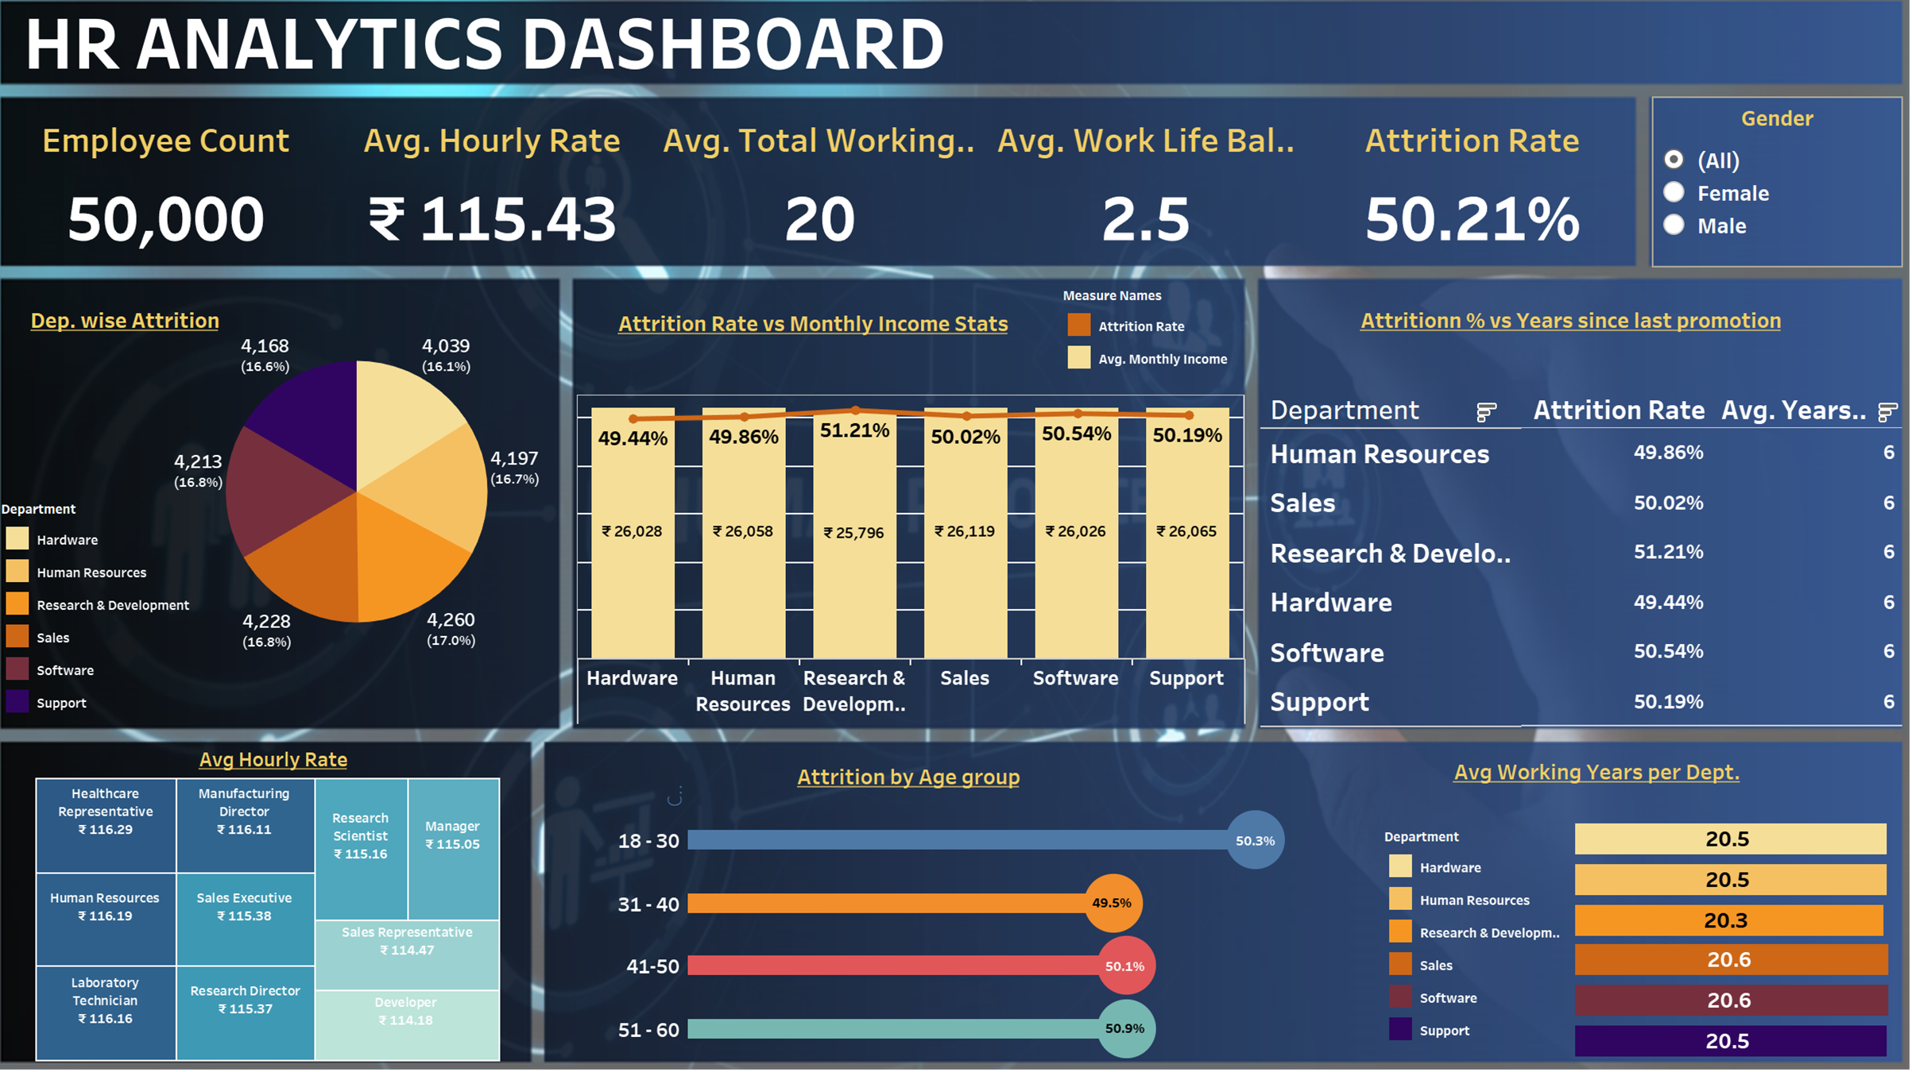

Slide 15
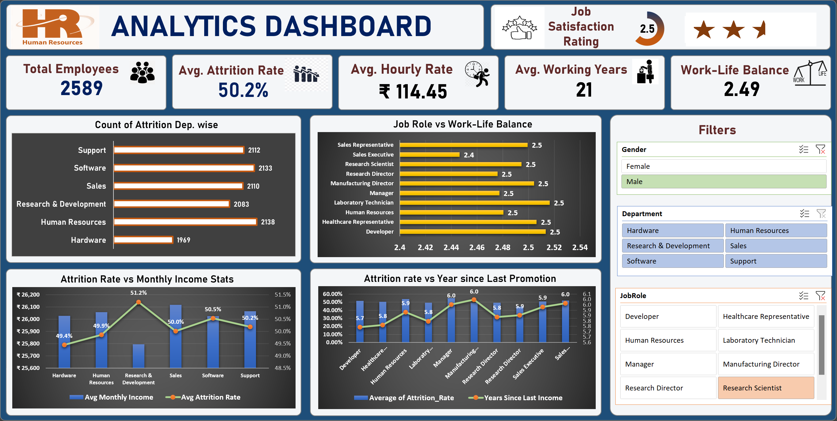

Slide 16
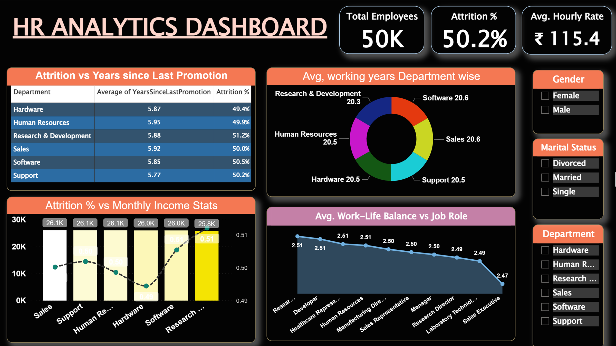

Slide 17
Thank You
Team 3
Shubham Shinde
Aniket Khartad

